Slide 1

Camera Module
Weipeng Lin

Slide 2

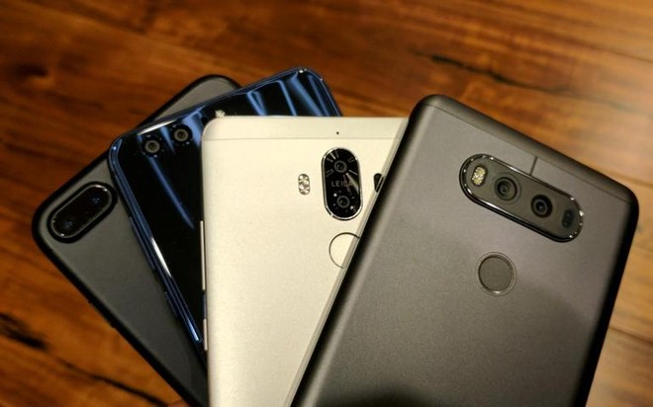

Slide 3
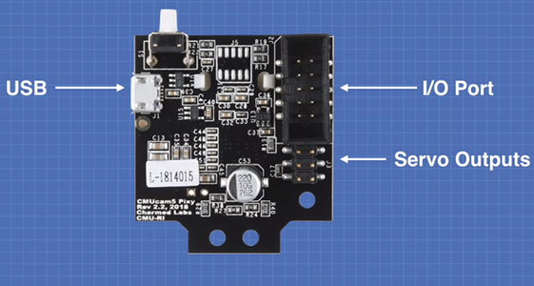
The basic structure of this Module
Processor: NXP LPC4330, 204 MHz,
Processor: NXP LPC4330, 204 MHz,
Processor: NXP LPC4330, 204 MHz,
Processor: NXP LPC4330, 204 MHz,
3.5 x 2.8 x 1.6 inches
Processor: NXP LPC4330
1296×976 resolution
Arduino
Raspberry Pi
Beaglebone Black
LEGO

Slide 4

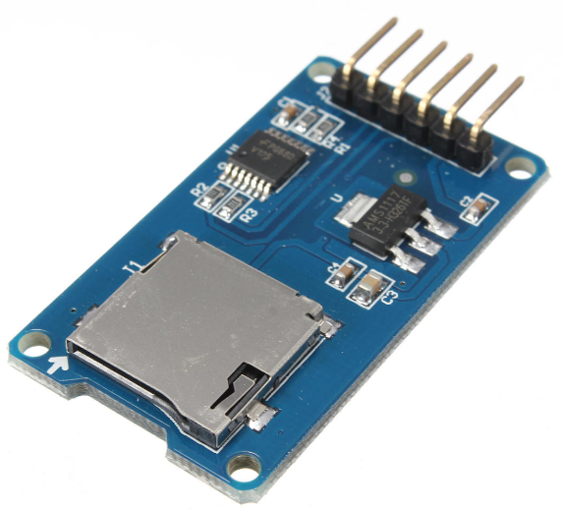
Other parts of this project

Slide 5
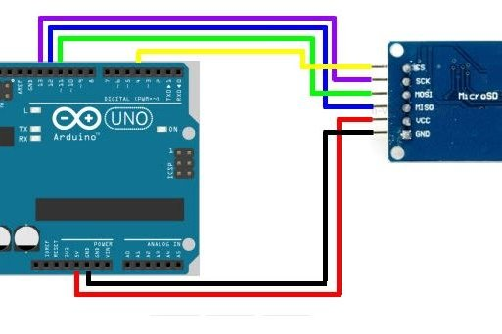
How to connect Arduino and SD card reader?

Slide 6
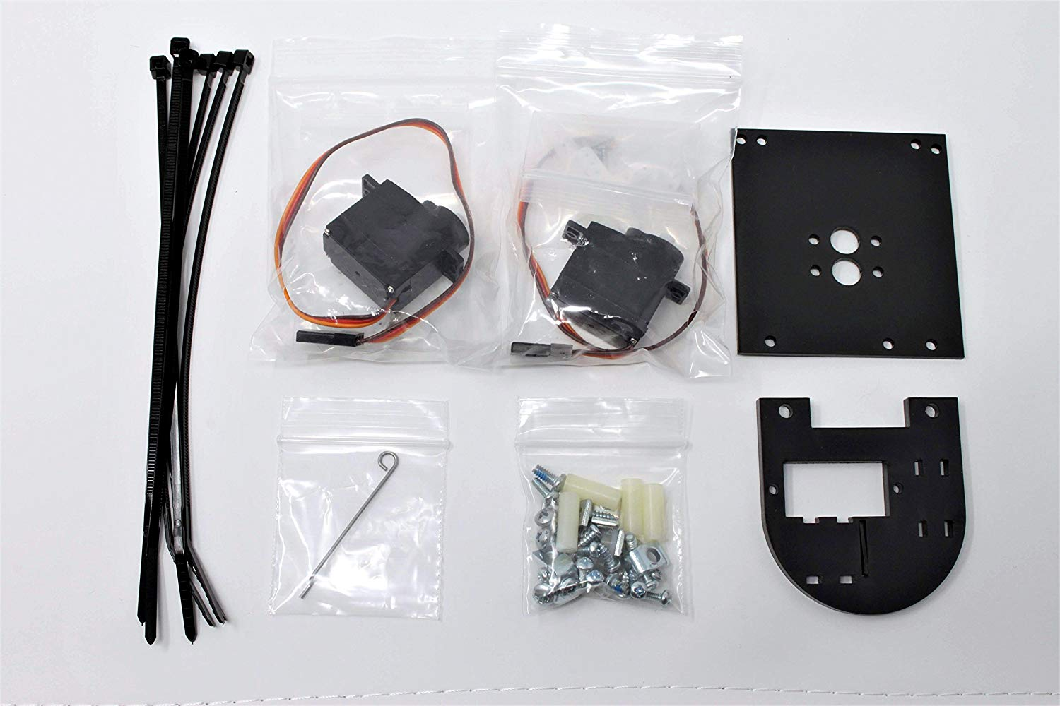
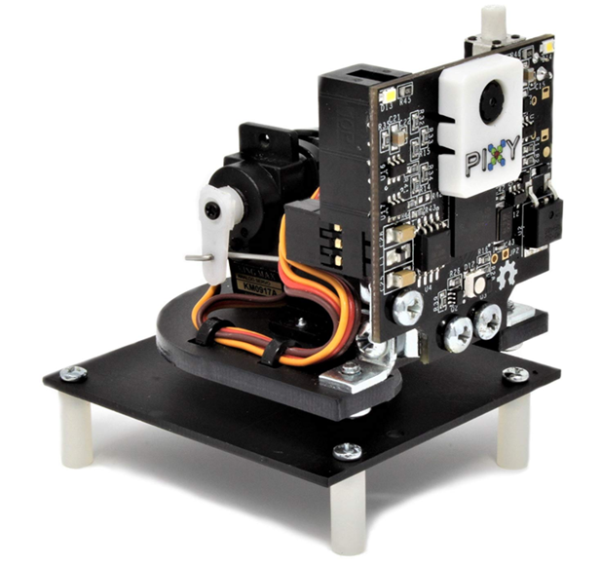
Addition module

Slide 7
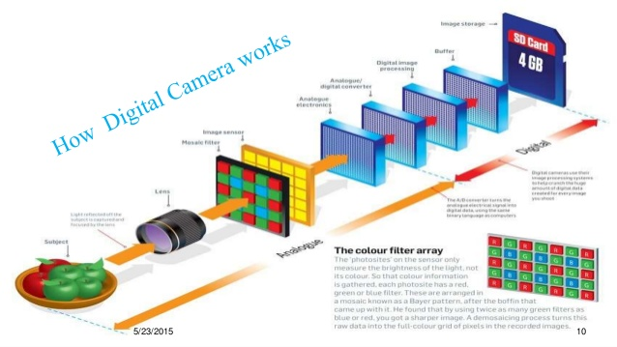

Slide 8


RGB yuv
The luminance signal Y
Chrominance signal U V

Slide 9
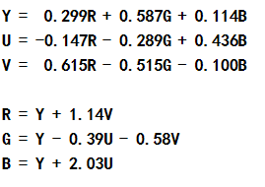
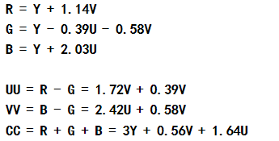
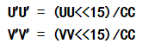
Calculation
The equation of RGB and YUV trans
Reduce the affect from the brightness

Slide 10
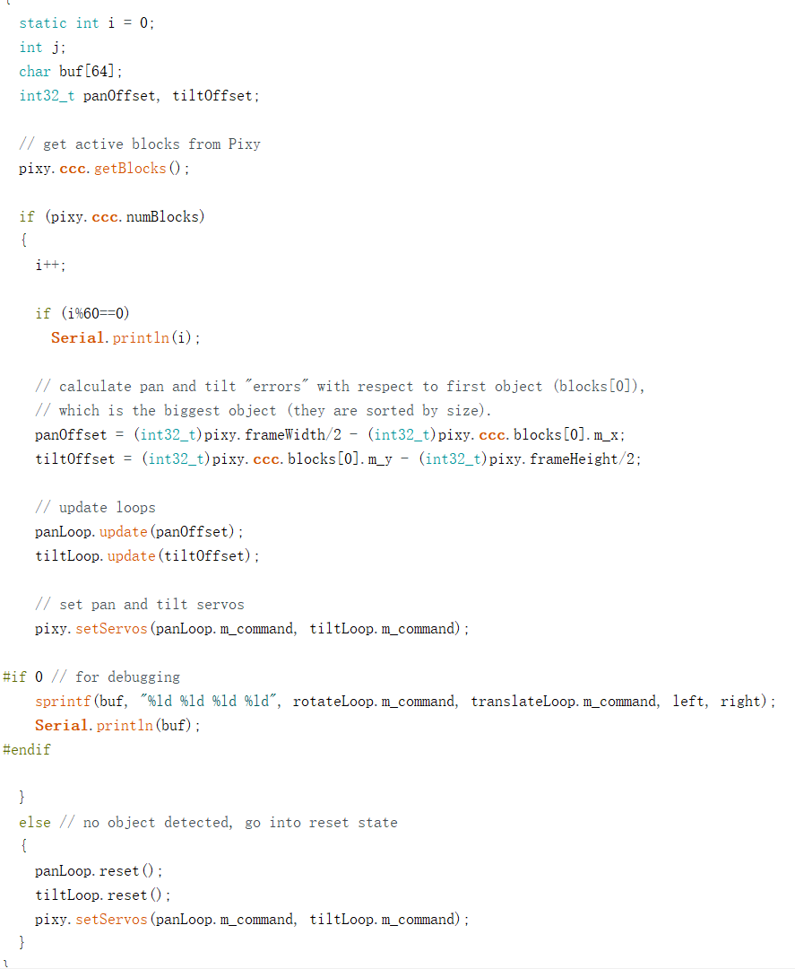
Code for tracking

Slide 11


Limited
Arduino
Raspberry Pi

Slide 12

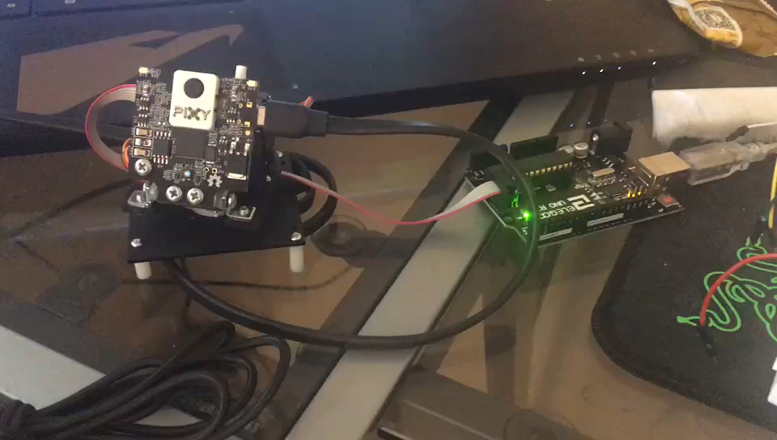
The video

Slide 13
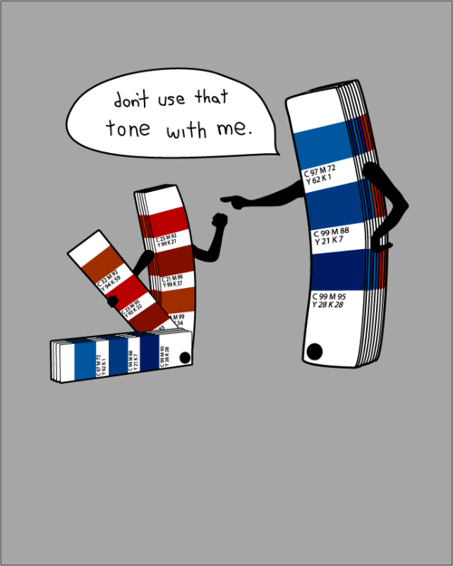
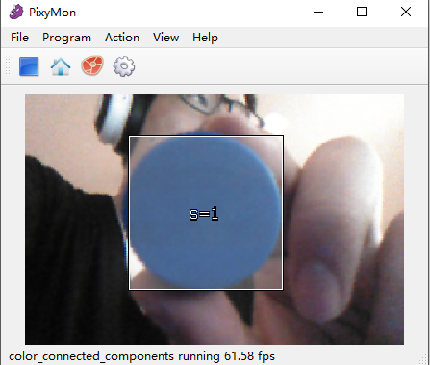
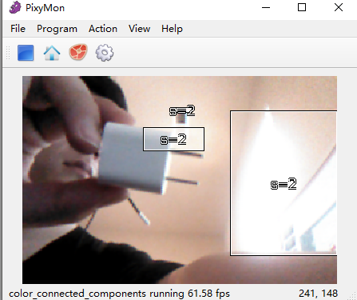

Slide 14

Limited

Slide 15
Cost
A Arduino -- $20
A Pixy2 camera module -$60
SD card and SD card reader -- $10
Wires and resistances -- $1

Slide 16
Reference
https://docs.pixycam.com/wiki/doku.php?id=wiki:v2:overview
https://randomnerdtutorials.com/guide-to-sd-card-module-with-arduino/

